Slide 1
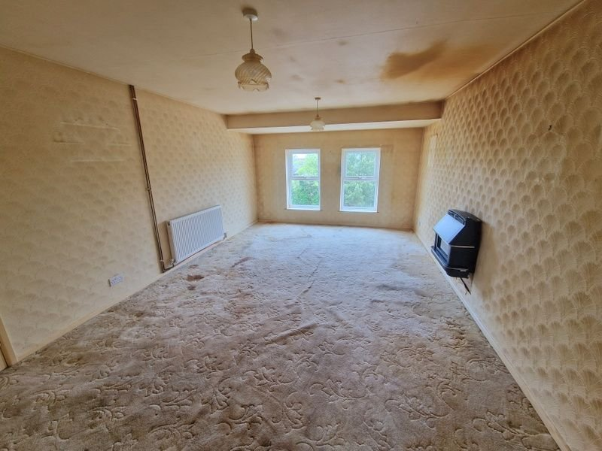
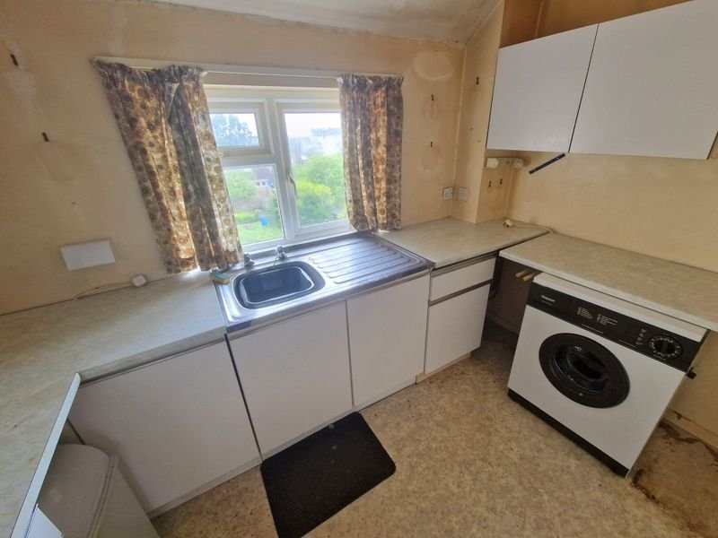
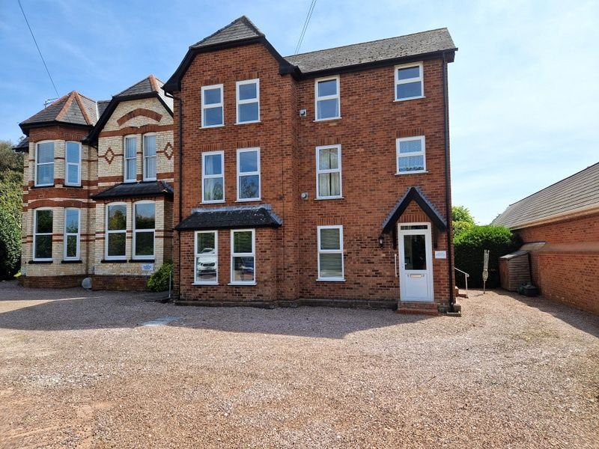
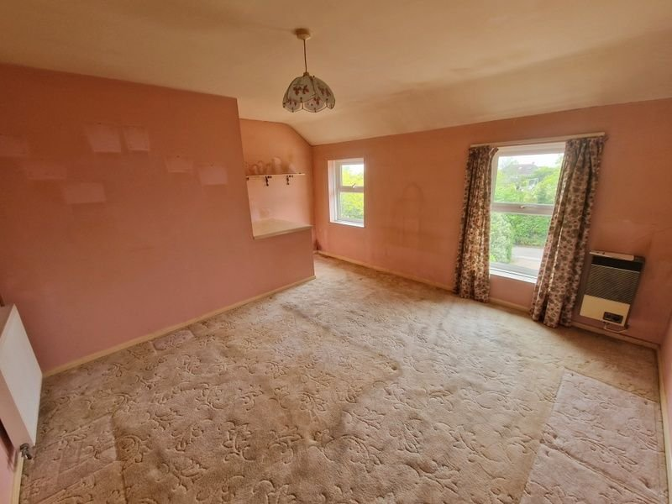
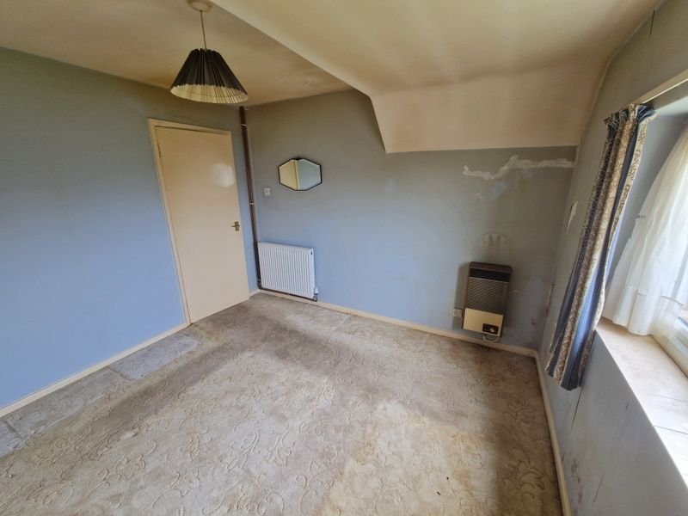
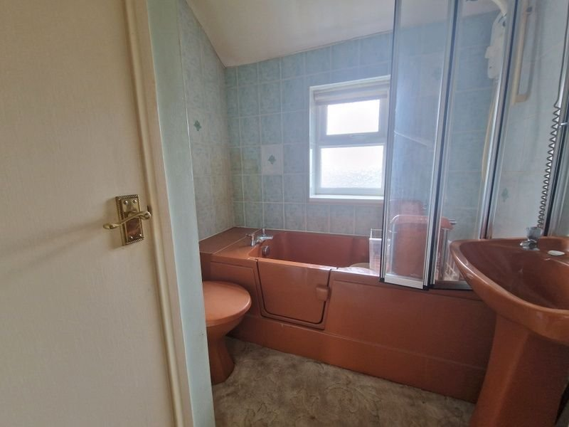
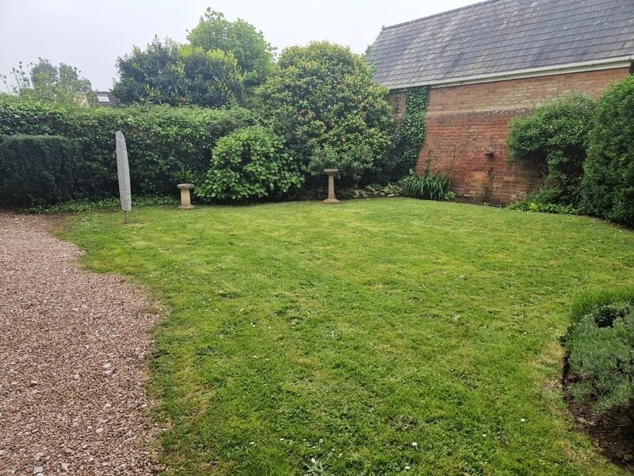
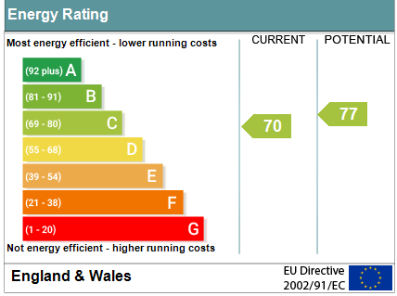
www.pennys.net
Flat 9 Elmdene, Long Causeway, Exmouth, EX8 1TS
GUIDE PRICE £179,950
TENURE Leasehold
A Purpose Built Top Floor Flat Ideally Located Close To The Health Centre, Town Centre And Seafront With Parking Area
Spacious Accommodation In Need Of Refurbishment * Lounge/Dining Room Separate Kitchen * Two Double Bedrooms * Bathroom/Wc * Gas Central Heating Via Modern Boiler * Upvc Double Glazed Windows * Super First Time Purchase * Newly Extended Lease * No Onward Chain
Pennys Estate Agents Limited for themselves and for the vendor of this property whose agents they are give notice that:- (1) These particulars do not constitute any part of an offer or a contract. (2) All statements contained in these particulars are made without responsibility on the part of Pennys Estate Agents Limited. (3) None of the statements contained in these particulars are to be relied upon as a statement or representation of fact. (4) Any intending purchaser must satisfy himself/herself by inspection or otherwise as to the correctness of each of the statements contained in these particulars. (5) The vendor does not make or give and neither do Pennys Estate Agents Limited nor any person in their employment has any authority to make or give any representation or warranty whatever in relation to this property.
PENNYS ESTATE AGENTS
2 Rolle House, Rolle Street, Exmouth, Devon, EX8 2SN
Tel: 01395 264111 EMail: help@pennys.net

Slide 2
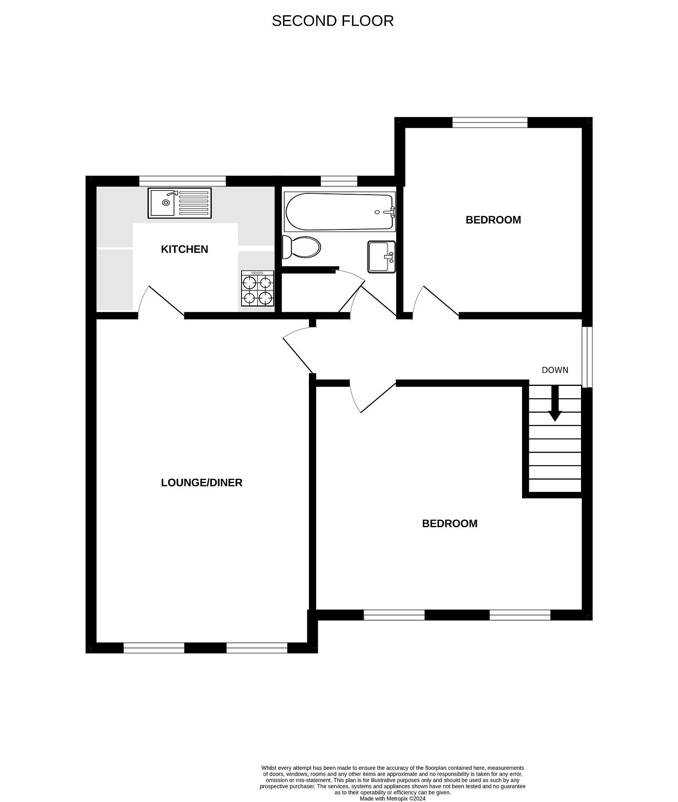
Flat 9 Elmdene Court, Long Causeway, Exmouth, EX8 1TS
Communal entrance with stairs rising to first floor. Private front door giving access to:
ENTRANCE HALL: uPVC double glazed window, stairs rising to second floor.
LANDING: Radiator, uPVC double glazed window, access to roof space, electric consumer unit.
LOUNGE/DINING ROOM: 5.49m x 3.63m (18'0" x 11'11") With two uPVC double glazed windows to front elevation enjoying an open outlook, fitted coal effect gas fire, radiator, TV point, door to:
KITCHEN: 3.02m x 2.11m (9'11" x 6'11") Comprising single drainer sink with adjoining work tops with cupboards and drawer units, plumbing for automatic washing machine beneath. Electric cooker point, wall mounted cupboards, space for upright fridge/freezer, uPVC double glazed window.
BEDROOM 1: 4.52m x 3.84m (14'10" x 12'7") Display surface over stairwell recess, radiator, two uPVC double glazed windows to front elevation.
BEDROOM 2: 3.23m x 3.05m (10'7" x 10'0") With uPVC double glazed window to rear elevation, radiator.
BATHROOM/WC: 2.13m x 2.03m (7'0" x 6'8") Comprising ease of access bath with shower unit over, part splashback walls, shower splash screen, pedestal wash hand basin with tiled splashback and mirror over, WC, cupboard housing gas boiler for hot water and central heating.
OUTSIDE: The property benefits from a parking area to the front and communal gardens to the rear. There is also a communal drying area.
TENURE: Newly extended lease – 110 years. Peppercorn ground rent. Service charges to be confirmed.
FLOOR PLAN:

